Slide 1



EDUp FORDCS V1.0 Release Management
Vienna, April.2022
F
Compendium
FORDSC Project
Edu Platform
v2022.04
MSc. Ömer Karacan
karacankos@gmail.com

Slide 2
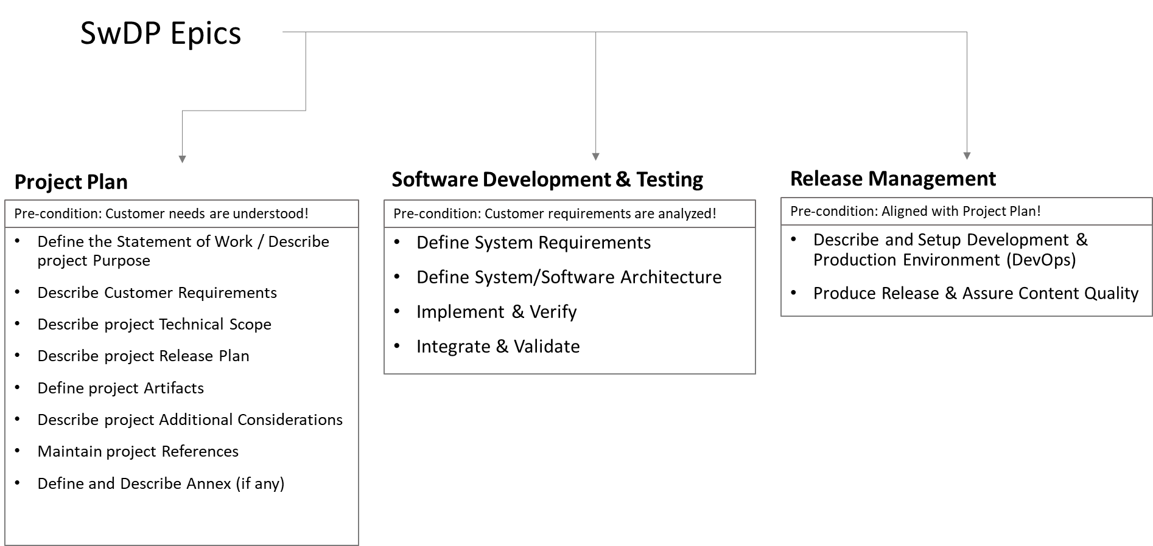
SwPD Method Epics - Setting Copy
Source: EDUp-Full-Stack-Software-Project-Development-Method.pptx

Slide 3
Development & Production Environment

Slide 5
Release Production & Quality Assurance

Slide 7
BACKYARD
BACKYARD

